Slide 1
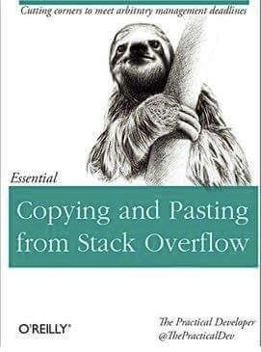

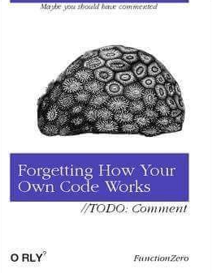
Today’s Themes

Slide 2
Git & GitHub
Control your Code Versions!
Ryan T. Hamilton, Instrument Scientist
Lowell Observatory, September 2018

Slide 3
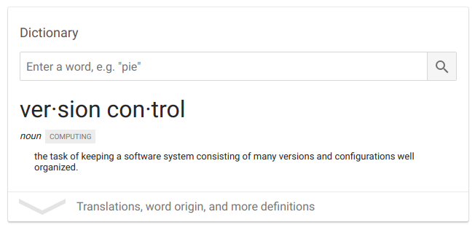
...Version Control?
Go Read: https://en.wikipedia.org/wiki/Version_control

Slide 4
Why Should I Use Version Control?
When done correctly, it helps you organize and plan
Reproducibility is a growing theme in astronomy
No one cares about your result using a fancy analysis if they can’t repeat it themselves
Sharing is Caring
How many person-hours have been wasted starting from scratch that could have been instead started at an intermediate point? Don’t always need to rewrite a parser.
Hard drives are so stupid cheap that you can save almost everything
>= $500,000/GiB 1981; <= $0.03/GiB now
You can snapshot your entire development process from start to finish

Slide 5
Why Should I Avoid Version Control?

Slide 6



Why Should I Avoid Version Control?

Slide 7
Bad Answers to that Last Slide
“This is a one-time thing”
Future you will hate current you
“It’s just me working on this”
Superman had visitors to his fortress of solitude. Same with Batman and the BatCave
“It’ll take too long to figure out how to do it”
Skill development is a real thing and isn’t just a waste of time
Barriers can be self-imposed or related to norms of the work culture and astronomy is largely terrible at dealing with these
“I don’t want to share my code”
I’m sorry you feel that way, hopefully you change your mind one day
“I don’t like ‘cloud’ apps or others hosting my data/work”
GitHub is an option, not a requirement. Can self-host with GitLab or work completely locally and backup in your preferred way

Slide 8
Ways of Controlling Versions
Common tools:
Manual (Important_done.cpp, Important_working.cpp, Important_v5.cpp)
You almost always end up having to guess based on file modification dates
Git
Gold standard for a while now; created for Linux development
Integrated with code sharing website GitHub
Mercurial (Hg)
Solid choice, free online GitHub competitor called BitBucket
Concurrent Versions System (CVS)
Please don’t use this
Subversion (SVN)
Evolution of CVS; it’s fine, I just don’t like it.
SourceForge was the O.G. and boosted SVN, but SourceForge went sketchy in 2015

Slide 9
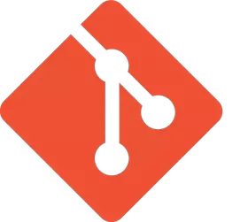
Git
https://github.com/git/git/tree/e83c5163316f89bfbde7d9ab23ca2e25604af290

Slide 10

There’s Always a Relevant XKCD
If that doesn't fix it, git.txt contains the phone number of a friend of mine who understands git. Just wait through a few minutes of 'It's really pretty simple, just think of branches as...' and eventually you'll learn the commands that will fix everything.

Slide 11

Theory and Lingo
Development Model: trees and branches!
Can move vertically (up and down) in the diagram below using git commands
“Clone” or “Pull”
“Merge”
“Commit”
Time/Commits

Slide 12
The (slight) Catch
“Commit” == checkpoint
git only works if you “commit” your changes as you go
Each commit is actually stored as just a set of diffs from the previous commit
You get to choose when and what files to commit
Committing binary files is possible, but can get out of hand
For that, try Git Large File Storage (Git LFS)

Slide 13
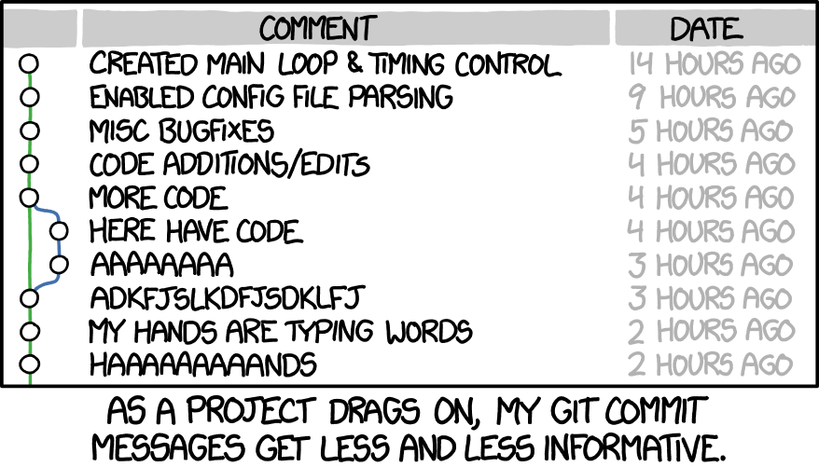
“But I’m not Good with Commitment”
Don’t let “future cleanup” stop you from performing commits
Show how the sausage is made! Software doesn’t spontaneously get perfect
Find what works for you
You don’t have to commit every character, but don’t only commit once a month
Regular commits allow you to go back and branch off easier
Also allows you to easier merge in other’s work
Get to the point but don’t be vague
Remember: You’re the most likely future user

Slide 14
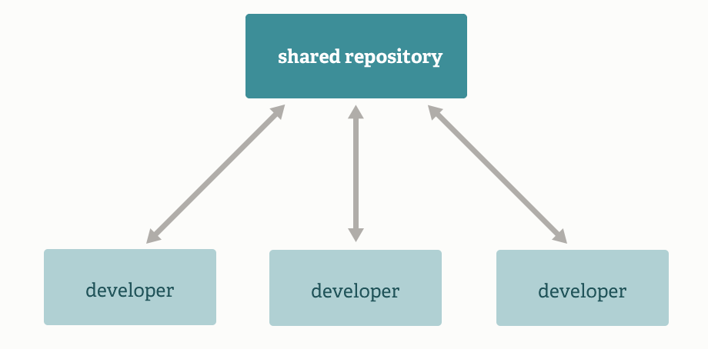
What Git Does
Contribution types: shared (hippie)

Slide 15
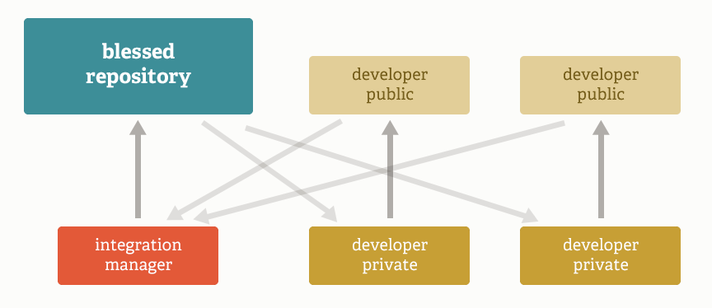
What Git Does
Contribution types: managed (May The Fork Be With You)

Slide 16
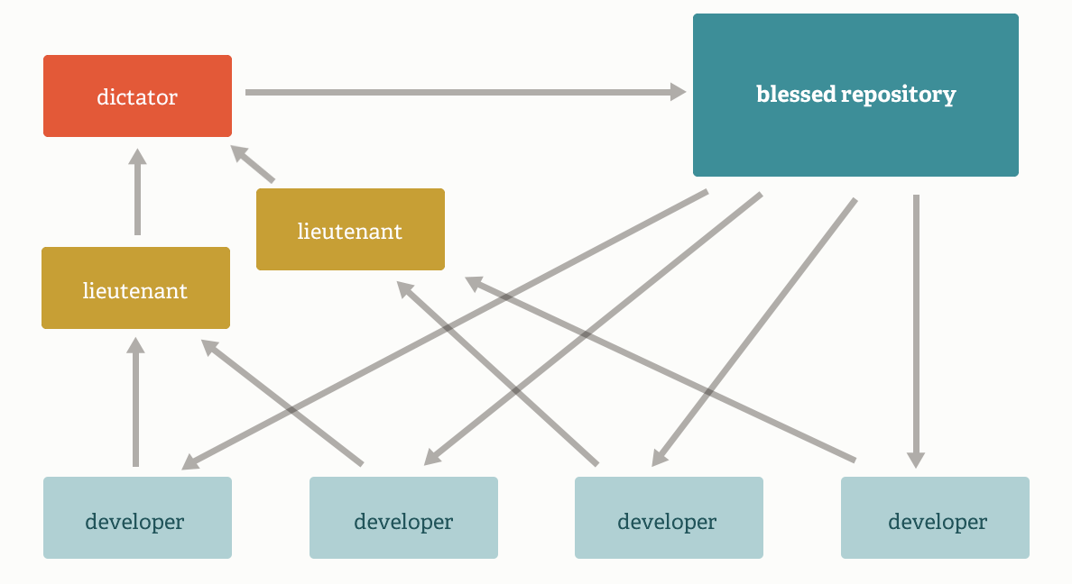
What Git Does
Contribution types: mafioso

Slide 17










What Git Does
Contribution types: mafioso

Slide 18
Git Quickstart
On Macs, if you’ve installed Xcode, you’ve already got git
If you haven’t installed Xcode, you can use either Homebrew or MacPorts to get it easily. The Xcode git version tends to be old but either of those will give you a current one
On Linux, it’s always just an apt-get (or yum or whatever) away
On Windows, there’s an installer that git distributes
On most platforms, there are also GUI options that sometimes give you a complete working bundle independent of the methods above
Atlassian’s SourceTree (Windows, Mac) is by far my favorite but they don’t have a Linux version. There, Git Kraken is king.
Git without a command line! Visual diffs, syntax colors, click to change branches. Awesome.
Your IDE probably has a git plugin too! It’s almost essential.

Slide 19
Before You Do Anything Else
git config --global user.name "Your Name"
Tell git who you are, will be used for all commit messages
git config --global user.email your.email@example.com
(same as above, really)
If you use GitHub (or any codesharing site, really) these could be public!
If you want to edit/find them in the future, look in ~/.gitconfig

Slide 20
Git Quickstart
Create a directory and go into it
git init
Make some initial files, or start from a completely blank slate
git add --all
git commit
Add in a message describing your changes and then save and quit
Done! You’ve created your first git repository.
<do some work>
“Commit” your new work
git status
Will show list of modified files
git add <modified files>
git commit

Slide 21
Additional git Commands
git log
Show your commit history
git status
Show a list of modified files, including any that are new/untracked
git show
Show the diff of the last (or specific) commit
git [mv, rm]
Act on a tracked file, moving (or removing) it and updating it appropriately in the history
‘git rm’ is not the inverse of ‘git add’ if you accidentally stage something
For that, you want ‘git rm --cached <file>’
git [fetch, push, pull]
Interact with a remote repository (like Github)
.gitignore

Slide 22

Additional git Commands
git log
Show your commit history
git status
Show a list of modified files, including any that are new/untracked
git show
Show the diff of the last (or specific) commit
git [mv, rm]
Act on a tracked file, moving (or removing) it and updating it appropriately in the history
‘git rm’ is not the inverse of ‘git add’ if you accidentally stage something
For that, you want ‘git rm --cached <file>’
git [fetch, push, pull]
Interact with a remote repository (like Github)
.gitignore

Slide 23

GitHub

Slide 24
Github Quickstart
Follow this: https://guides.github.com/activities/hello-world/
It lets you:
Create a repository
Copy (clone) another one and work on it
Request that the one you cloned include some of your changes (“pull request”)
Create an “issue” describing a problem in a repository and talk about it
See also: Jira
Comment on a given commit, or even a line in a specific commit
Explore branches, the commit history, etc.
Create teams and groups, assigning permissions accordingly
Create releases, tagged versions, etc.
Use continuous integration systems to build and record each commit
Host static webpages even with HTTPS and custom domain support!

Slide 25
Demos
Simple repository: https://github.com/LowellObservatory/DeadParrots
Simple issue: https://github.com/LowellObservatory/DataServants/issues/8
Simple project: https://github.com/LowellObservatory/DataServants/projects/1
Complex everything: https://github.com/astropy/astropy
Static HTTP: https://github.com/astrobokonon/astrobokonon.github.io
https://pages.github.com/
Quick demo of SourceTree

Slide 26
Github Things of Note
You should figure out what license you want (or are required) to post your code with. Unlicensed/ambiguous licensed code is dead code.
https://help.github.com/articles/licensing-a-repository/
https://choosealicense.com/
Now owned by Microsoft so it could decay when they change CEOs
See also: Nokia, Skype, their enterprise/paywall shenanigans
To have private repositories with collaborators, you’re going to have to pay
It’s possible to host a git server which allows pushing from other machines but doesn’t have any bells and whistles that a web interface that Github has
We have one on jumar already, for example

